Slide 1
Operators
An operator is a symbol that performs an operation.
Arithmetic Operators
Relational Operators / Comparison Operators
Logical Operators
Assignment Operators
Bitwise Operators
Membership Operators
Identity Operators

Slide 2
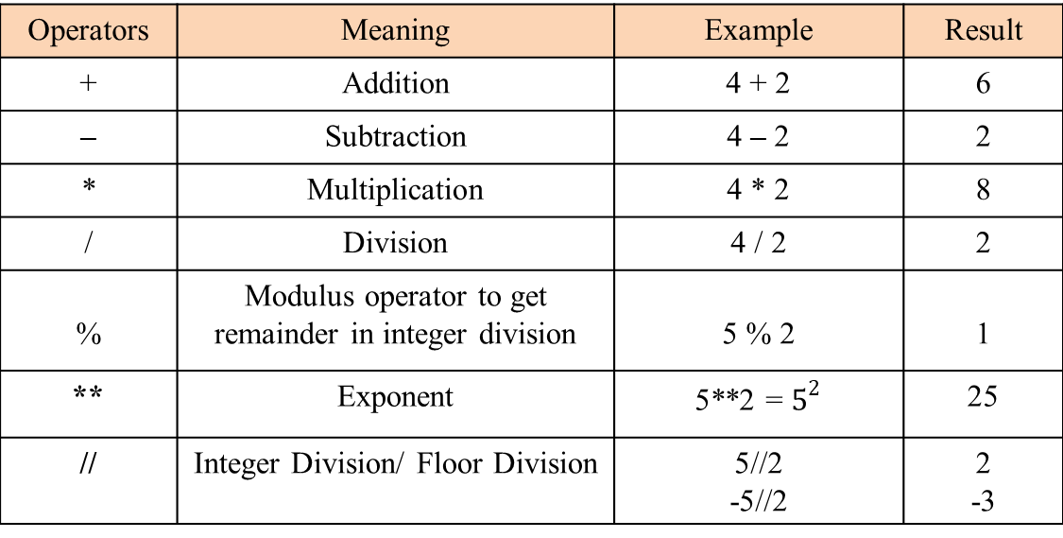
Arithmetic Operators
Arithmetic Operators are used to perform basic arithmetic operations like addition, subtraction, division etc.
Operators | Meaning | Example | Result
+ | Addition | 4 + 2 | 6
– | Subtraction | 4 – 2 | 2
* | Multiplication | 4 * 2 | 8
/ | Division | 4 / 2 | 2
% | Modulus operator to get remainder in integer division | 5 % 2 | 1
** | Exponent | 5**2 = $5^{2}$ | 25
// | Integer Division/ Floor Division | 5//2 -5//2 | 2 -3

